Slide 1
Data Structures
H16Y 35

Slide 2
Part E: Hashing (Hash Tables & Functions)

Slide 3
Introduction.
Hash tables are also regarded as forms of data structures used in computer programming to perform specific operation/implementation.
A Hash Table is a data structure made up of two parts, a table (or array) of data, and a key, which identifies the location of the data within the table.
A ‘Hashing algorithm’ is carried out on the key, which then acts as an index to the specific location of that data item within the array.
Hashing generally use specific data structures (i.e. Hash Tables) to perform given operations.
One of the purpose of using Hash Table data structures is to support specific operations (deletion, insertion, search….) during computer program implementation
The mapping between an item and the slot where that item belongs in the hash table is called the Hash Function.
To hash a value means simply to apply a function that transforms a possibly non-integer key into an integer value

Slide 4
What is Hashing?
Hashing is a very common technique used for sorting data in such a way that the data can be inserted, retrieved or deleted very quickly.
Hashing uses Harsh Table data structures to perform given operations in computer programming.
Hashing can also be referred to as a technique used to convert a range of key values into a range of indexes of an array.
It involves applying a hashing algorithm to a data item, known as the hashing key, to create a hash value
Hashing has two main applications:
To speed data retrieval, and
To check the validity of data.

Slide 5
Hash Tables
A hash table is a data structure made up of two parts, a table (or array) of data, and a key, which identifies the location of the data within the table.
A hash table is an array with index range: 0 to TableSize – 1
Most commonly used data structure to implement symbol tables
Insertion and lookup can be made very fast – O(1)
A hash function maps an identifier name into a table index
A hash function, h(name), should depend solely on name
h(name) should be computed quickly
h should be uniform and randomizing in distributing names
All table indices should be mapped with equal probability
Similar names should not cluster to the same table index

Slide 6
Types of Hashing
Static Hashing:
In static hashing, the hash function maps search-key values to a fixed set of locations.
Dynamic Hashing:
In dynamic hashing a hash table can grow to handle more items. The associated hash function must change as the table grows.

Slide 7
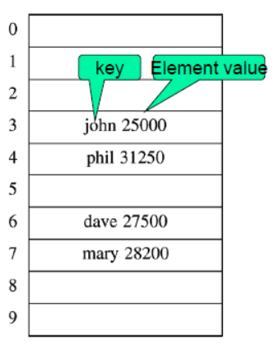
Hash Table – Cont’d
Hash table is an array of fixed size
TableSize.
Array elements indexed by a key, which is mapped to an array index
(0…TableSize-1).
Mapping (hash function) h from key to index
E.g., h(“john”) = 3.

Slide 8
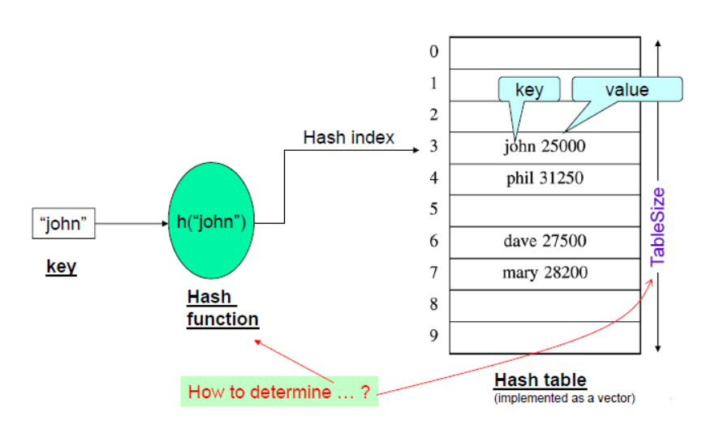
Hash Table – Main Components

Slide 9
Hash Operations.
Typical hash table operations include the following:
Initialization.
Insertion –
insert an element in a hashtable.
Searching –
search an element in a hashtable.
Deletion –
delete an element from a hashtable.

Slide 10
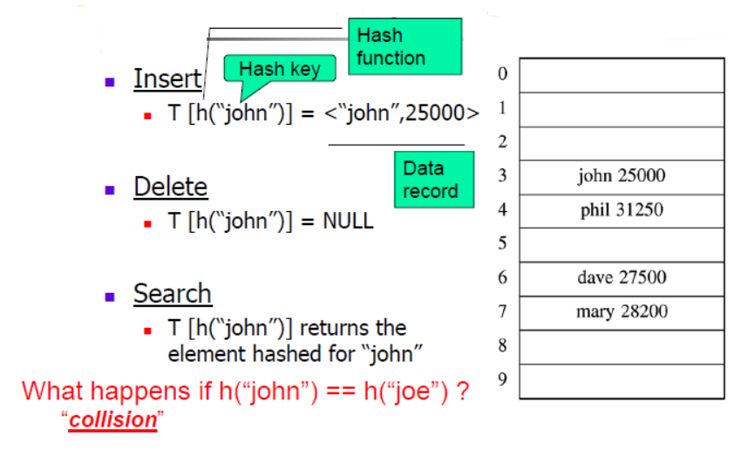
Hash Operations

Slide 11
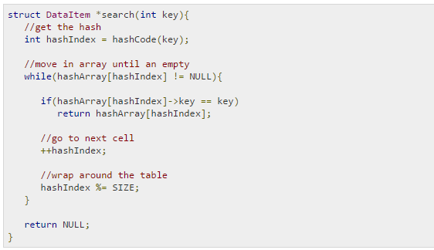
Hash Operations
Search Operation

Slide 12


Hash Operations
Initiation/Definition Operation

Slide 13
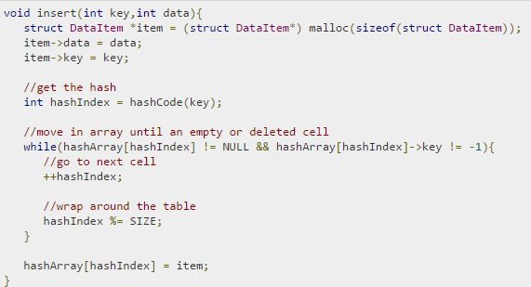
Hash Operations
Insert Operation

Slide 14
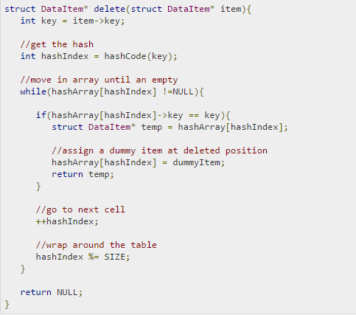
Hash Operations
Delete Operation

Slide 15
Types of Hash Tables.
An Open-addressed Hash Table:
This is a one-dimensional array indexed by integer values that are computed by an index function called a hash function.
A Separate-Chained Hash Table:
This is a one-dimensional array of linked lists indexed by integer values that are computed by an index function called a hash function.

Slide 16
Hash Functions
A hash function is one which maps an element’s key into a valid hash table index
Function: h(key) => hash table index
Note that the above hash function is (slightly) different from saying:
h(string) => int
Because the key can be of any type
E.g., “h(int) => int” is also a hash function!
But also note that any type can be converted into an equivalent string form

Slide 17
Hash Functions – Cont’d
A hash function, h, is a function which transforms a key from a set, K, into an index in a table of size n:
h: K -> {0, 1, ..., n-2, n-1}
A key can be a number, a string, a record etc.
It is possible for different keys to hash to the same array location, when this occur it is called collision and the colliding keys are called synonyms.

Slide 18
Hash Functions – Cont’d
Characteristics of a ‘good hash function’
A good hash function should contain the following:
Minimize collisions.
Be easy and quick to compute.
Distribute key values evenly in the hash table.
Use all the information provided in the key.

Slide 19
Hash Functions - Properties
A hash function maps key to integer
Constraint: Integer should be between [0, TableSize-1]
A hash function can result in a many-to-one mapping - (causing collision)
Collision: occurs when hash function maps two or more keys to same array index
Note: Collisions cannot be avoided but its chances can be reduced using a “good” hash function
A “good” hash function should have the properties:
Reduced chance of collision: Different keys should ideally map to different indices
Distribute keys uniformly over table
Should be fast to compute

Slide 20
Factors That Affects Hash Tables
Hash function
Table size
Usually fixed at the start
Collision handling scheme
A collision occurs when h(name1) = h(name2) and name1 ≠ name2
Note:
Collisions are inevitable because
The name space of identifiers is much larger than the table size

Slide 21
How To Resolve Collision
What happens when h(k1) = h(k2)?
==> collision !
Methods of Resolving Collision problems
Collision resolution strategies include the following
Chaining:
Store colliding keys in a linked list at the same hash table index
Open addressing:
Store colliding keys elsewhere in the table

Slide 22
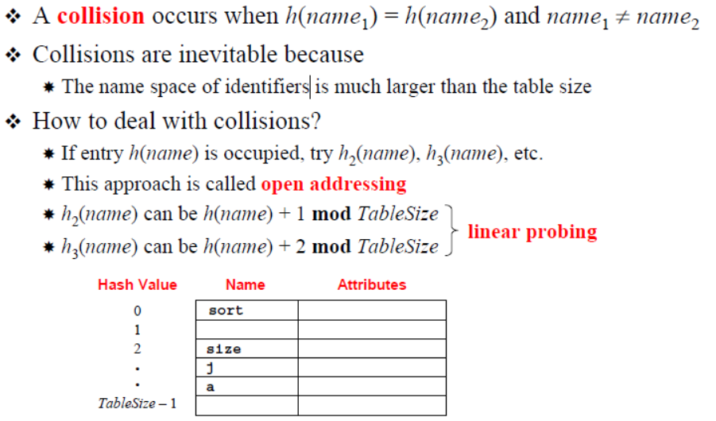
How To Resolve Collision – Open Addressing

Slide 23
Hash Tables Application/Benefits
Database systems: Specifically, those that require efficient random access. Generally, database systems try to optimize between two types of access methods: sequential and random. Hash tables are an important part of efficient random access because they provide a way to locate data in a constant amount of time.
Symbol tables: The tables used by compilers to maintain information about symbols from a program. Compilers access information about symbols frequently. Therefore, it is important that symbol tables be implemented very efficiently.
Data dictionaries: Data structures that support adding, deleting, and searching for data. Although the operations of a hash table and a data dictionary are similar, other data structures may be used to implement data dictionaries. Using a hash table is particularly efficient.
Network processing algorithms: Hash tables are fundamental components of several network processing algorithms and applications, including route lookup, packet classification, and network monitoring.
Browser Cashes: Hash tables are used to implement browser cashes.

Slide 24
When not to use Hash Tables
Problems for which data ordering is required.
Because a hash table is an unordered data structure, certain operations are difficult and expensive. Range queries, proximity queries, selection, and sorted traversals are possible only if the keys are copied into a sorted data structure. There are hash table implementations that keep the keys in order, but they are far from efficient.
Problems having multidimensional data.
Prefix searching
Especially if the keys are long and of variable-lengths.
Problems that have dynamic data:
Open-addressed hash tables are based on 1D-arrays, which are difficult to resize once they have been allocated. Unless you want to implement the table as a dynamic array and rehash all of the keys whenever the size changes. This is an incredibly expensive operation. An alternative is use a separate-chained hash tables or dynamic hashing.
Problems in which the data does not have unique keys.
Open-addressed hash tables cannot be used if the data does not have unique keys. An alternative is use separate-chained hash tables.

